Slide 1

Python Style Printing

Slide 2
Reference
Youtube
Code

Slide 3
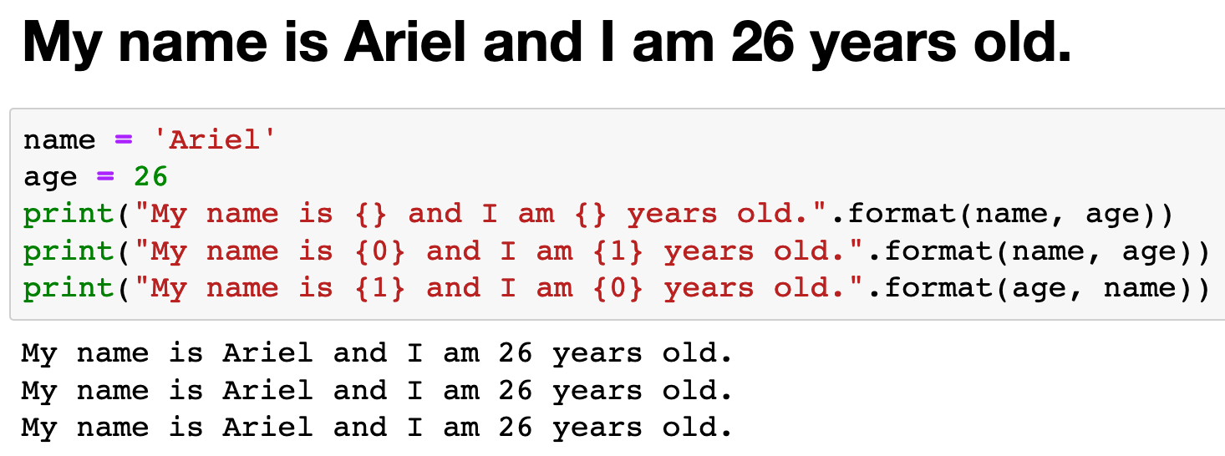

Slide 4
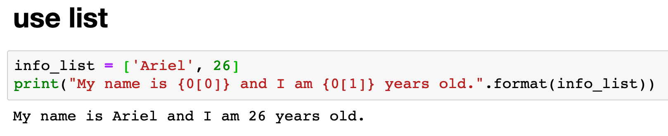

Slide 5
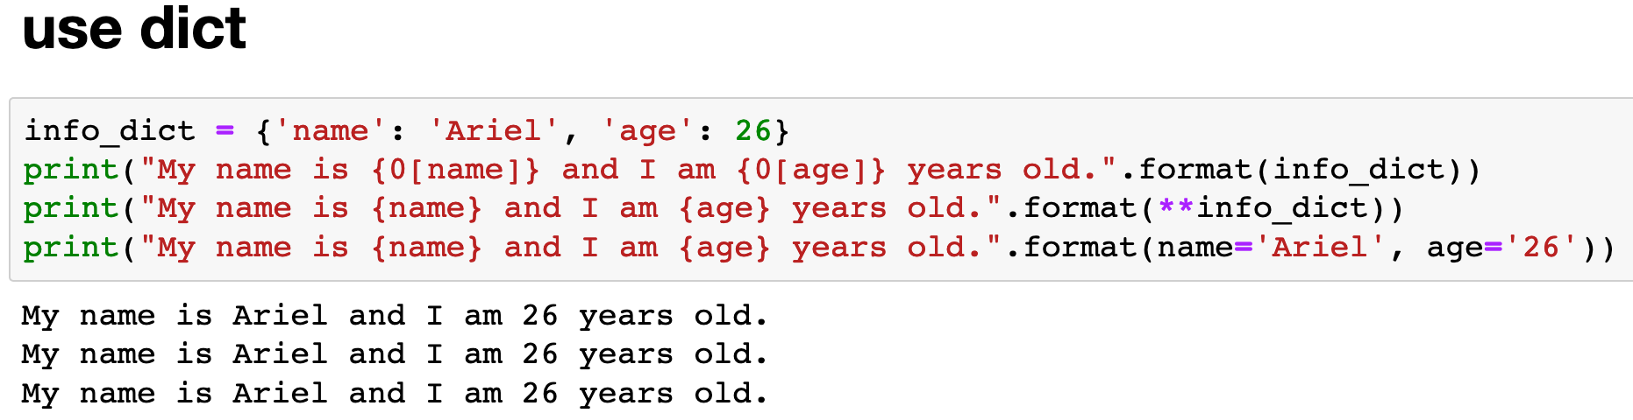

Slide 6
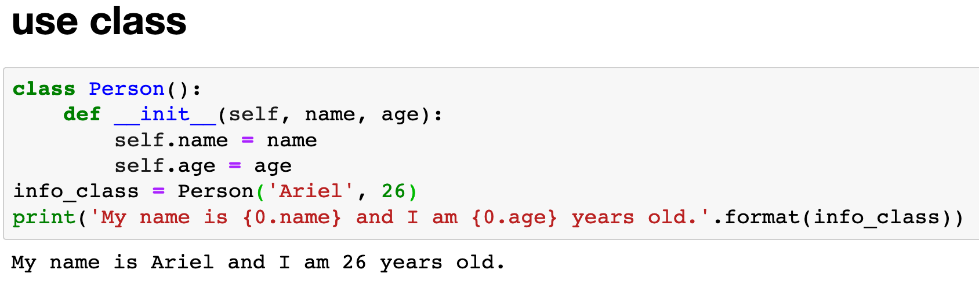

Slide 7
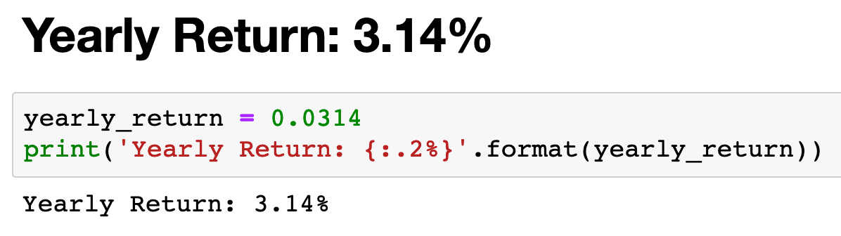

Slide 8
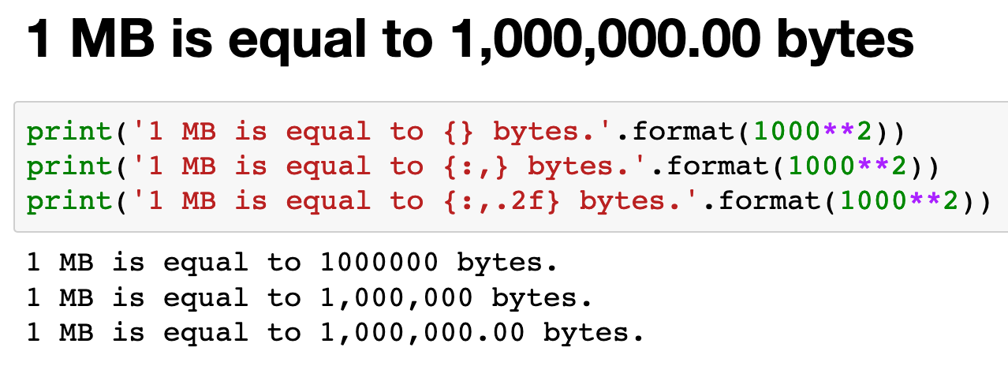

Slide 9
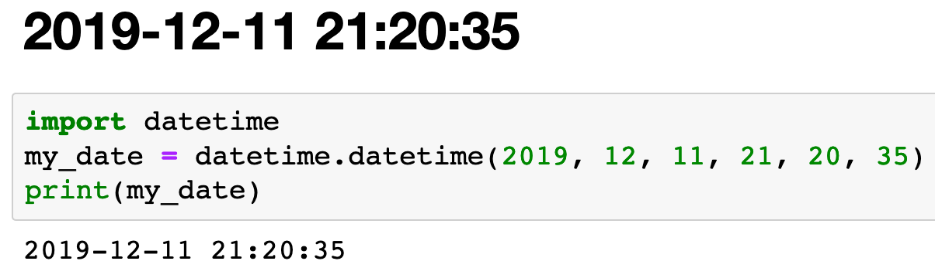

Slide 10
%A Weekday full
%a Weekday abbreviated
%B Month full
%b Month abbreviated
%d Day of the month (2 digits)
%j Day of year
%Y Year (4 digits)
%y Year (2 digits)
datetime

Slide 11
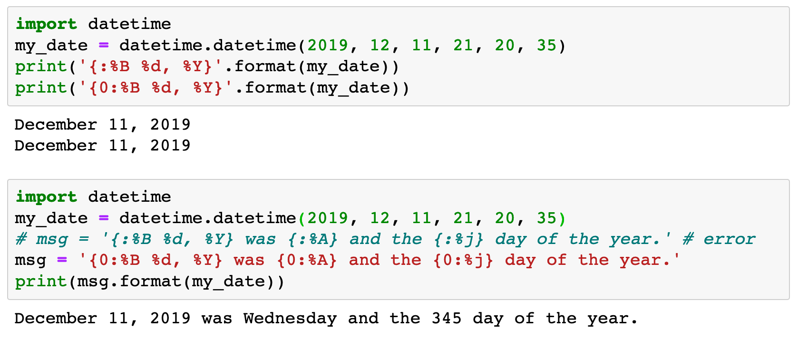

Slide 12
Now
Let’s Play with Code

